Slide 1

Power Enjoy
Software Engineering 2 Project
Niccolo’ Raspa
Matteo Marinelli

Slide 2
What is Power Enjoy?
Digital management system for car-sharing service
Eco friendly, exclusively employs electric car
Based in Milan

Slide 3
Text Assumption
Park in an Unsafe Area
Restrictive to Prevent this situation from happening
One Hour Clock
Payments
External Service that takes care payment process
Multiple Discounts
Discount only applied if car is a safe area
Only Shared Ride discount is cumulative
Fines over Discount

Slide 4
Domain Assumption
CORRECTNESS AND AVAILABILITY OF INFORMATIONS
CAR FUNCTIONALITIES
EXTERNAL SERVICES

Slide 5
Domain Assumption - Car
Power Enjoy service employs a single model of electric car in the first release, but the system is designed to allow any electric vehicle as long as is provides the minimum functionality needed:
Weight sensors
Ignition sensors
Battery Level sensors
Global Positioning System (GPS)
Other models should also consider this non functional requirements that will highly affect the quality of the service we provide:
Battery Length
Charging Time
Safety
Automatic keyless entry
Remote control
Lcd touchscreen
Internet connectivity
Comfort
Performance
Navigation System

Slide 6
Goal ???

Slide 7
Requirements Derivation
Scenarios
Use Cases
Identification Requirements
Traceability matrix ensure G = D + R

Slide 8
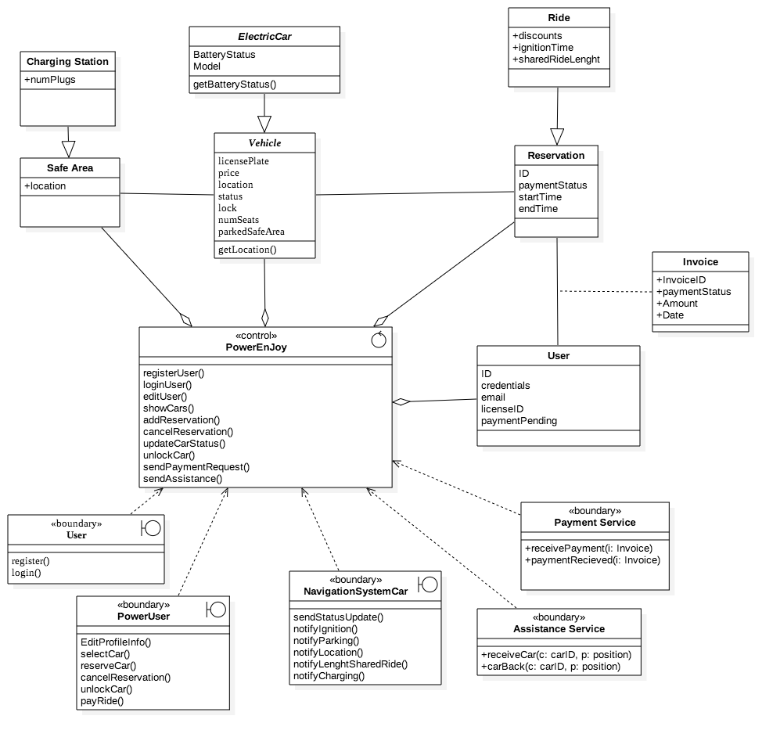
CLASS
DIAGRAM

Slide 9

ENTITY
CONTROL
boundary

Slide 10
database
application
CLIENT
EXTERNAL SERVICES

Slide 11
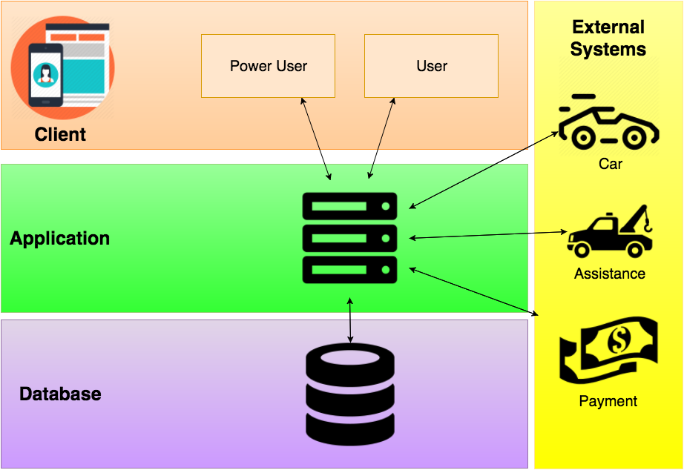

Slide 12
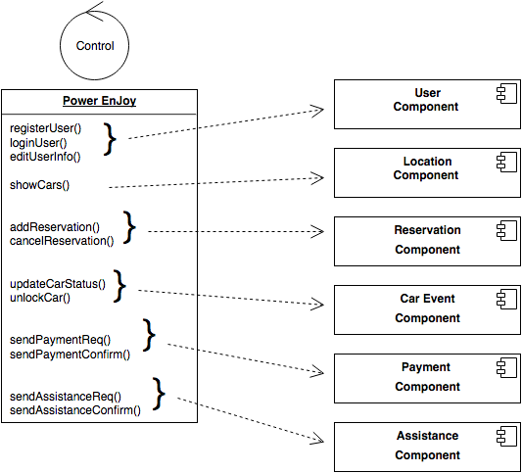
Application Layer
This components implements the logic of the Power Enjoy Application, it’s the core of our business

Slide 13



Application Layer - Implementation
Java Enterprise Edition 7 (JEE)
Modular Components
Large Scale
Multi Tiered
Scalable
Enterprise Java Beans (EJB)
Encapsulate Business Logic
GlassFish as Application Server
Supports JEE7
Additional Features (Security, Load Balancing)

Slide 14
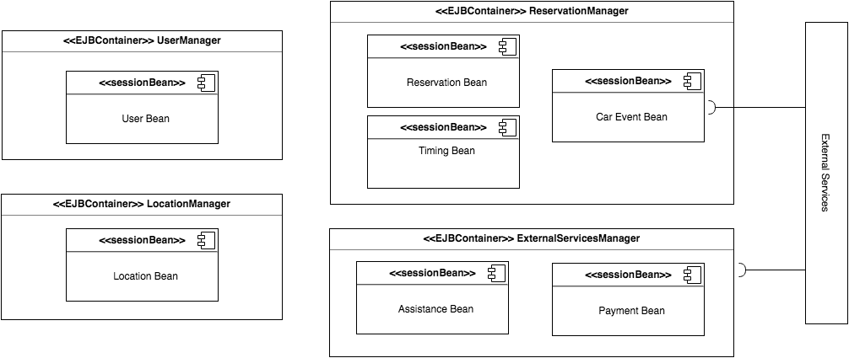
Application Layer - EJB

Slide 15
Client Layer
Considerations:
Mobility In Mind
Mobile First
Expected Functionalities:
Registration
Login
Edit Profile
See Recent Rides
Reservation/Ride
Make Payment

Slide 16
Client Layer
Considerations:
Mobility In Mind
Mobile First
Expected Functionalities:
Registration
Login
Edit Profile
See Recent Rides
Reservation/Ride
Make Payment
}
Profile Management
}
Car Sharing

Slide 17
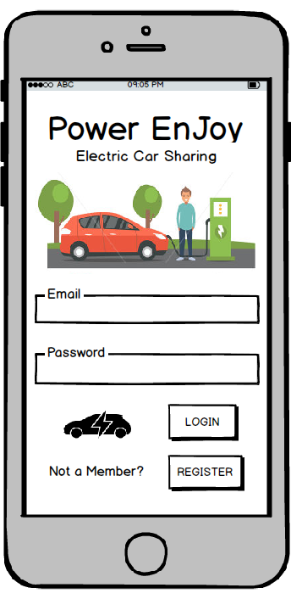
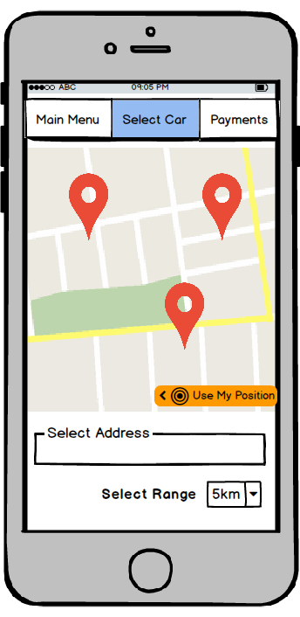
Client Layer - Mobile App
Mobile App implements all expected functionalities
Mobile First but not Mobile Only:
visibility
accessibility
scalability

Slide 18
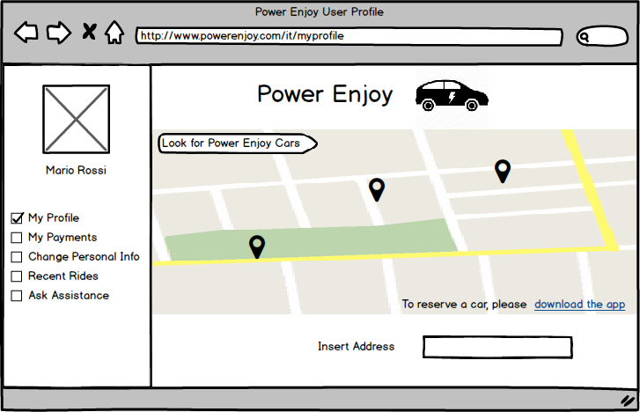
Client Layer - Web Server
Support to Mobile App
New Tier?

Slide 19
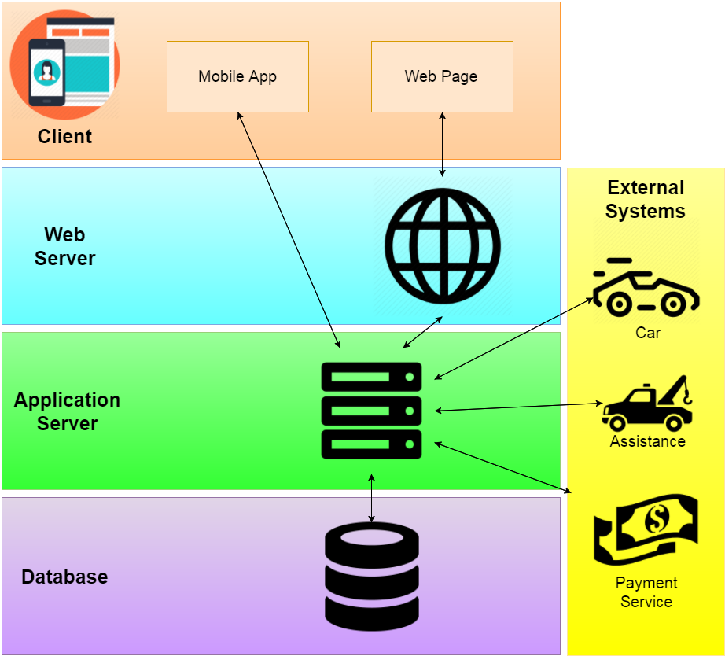

Slide 20
Client Layer - Implementation
Web Server:
GlassFist with Java Server Pages
Communication to Application Server via RESTful APIs
Mobile App:
Cordova
Cost Effective: free
Easy to modify: open source
Resource Effective: target multiple devices with one codebase

Slide 21
Some Problems…
Problems
Application Server is the bottleneck of our system
The performance of this layer is strictly related to the overall performance of the system
Solutions
Multithreading?
Sure, but we can do better…

Slide 22
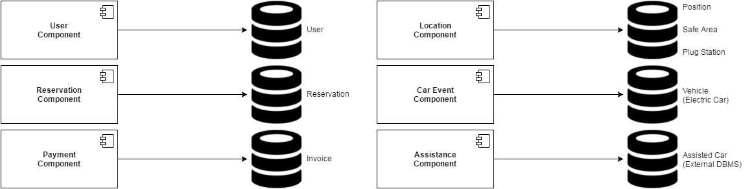
Moving to a SOA approach
Split the workload among different services
Simple and clear Interface to other components
Each component is responsible for some entities in the database

Slide 23
Benefits
• It’s a more clean architecture. Every component implements a service and provides an interface to all the other services.
• Changing/optimising each module will not affect the whole system as long as we maintain the same interface for each component.
• It’s very flexible, it’s will be easy in the future to add new functionalities.
• We can divide the databases among different regions (e.g. for the city of Milan we don’t need to keep track of the cars in Turin)

Slide 24
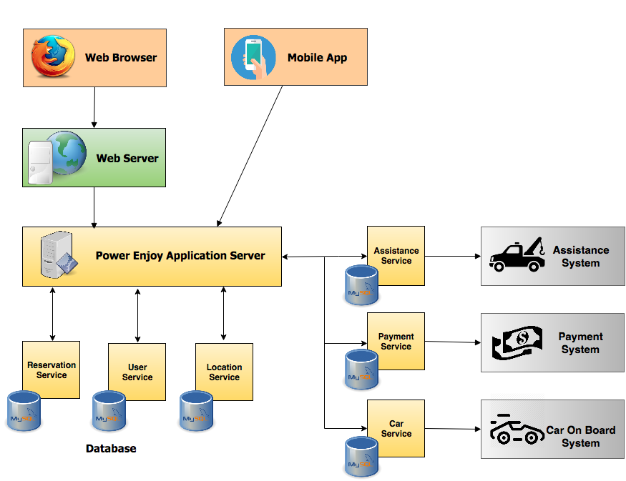

Slide 25
Entry Criteria
Stakeholder Approval
Website and Mobile App
communication between the Application Server and Clients, both via the Mobile App and via the Web Server, must have clearly structured
Coding and Testing Application Layer
Unit test
Documentation and Code Inspection
Object Relational Mapping (each service to its respective database)

Slide 26
Integration and Testing
Elements to be integrated are:
Integration of the different services inside the Application Layer
Integration of different tiers (Client - Web - Application)
Integration and configuration with third party systems (Payment System, Assistance System)

Slide 27
Integration Strategy
Mixture of the bottom-up and functional-grouping
critical components first
start from small independent service
group them to implement complex functionalities
Relation with third party
fixes might delay the process

Slide 28
Integration Strategy
Ensure that services in relations with external systems works as expected
Ensure that we have control over the Car
Integration of Services
Integration with top layers
Alpha Test

Slide 29
Integration of Services
LOCATION OF VEHICLES
LOCATION OF USER
RESERVATION

Slide 30
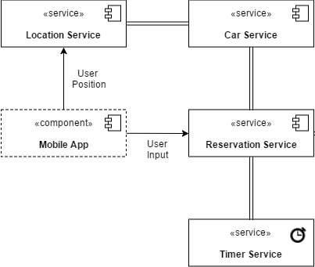
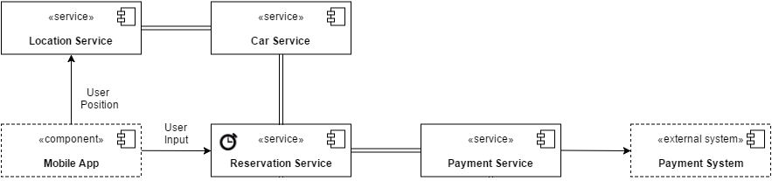
Integration of Services
TIMING
PAYMENT

Slide 31
Integration of Services
WHOLE SYSTEM

Slide 32
Tools Used
Mockito
Arquilian
JUnit
Manual Testing

